Slide 1

Analysis of Telemonitoring Data Collected From Parkinson’s
Clustering, Classification, Association Rules
Submitted by, Veeresh Kondapaneni, Parth Bhatt, Brian Lear, Srushti Nayak, Priya Dobariya
Guided by, Prof. Dr. Changcui Zhang

Slide 2


Work in progress

Slide 3
Parkinson’s Disease is a Neurodegenerative Disorder
Dopamine system
Degenerative
Cause unknown
Progression well known

Slide 4
Treatment is Pharmacological
Treated by regulating dopamine system
Diminishing returns

Slide 5
Previous Work
Data gathered using specially build equipment
Clinician measurements can be considered objective
Regression analysis not fruitful

Slide 6
Potential to Enhance Outcomes
Speculative analysis
Longer efficacy immediate benefit
Reduce cost
Increase availability
Regulate with medication port

Slide 7
K-means Clustering
KMeans : It forms clusters based on cluster centroids(tries to minimize sum of squared error).
The accuracy for KMeans is : 93.62%
The confusion matrix we got is: [[ 0 27 35
0 61 10
0 3 489]]

Slide 8
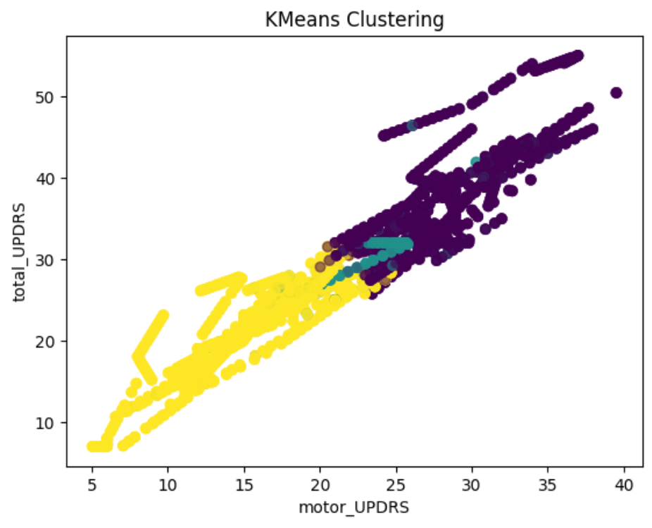
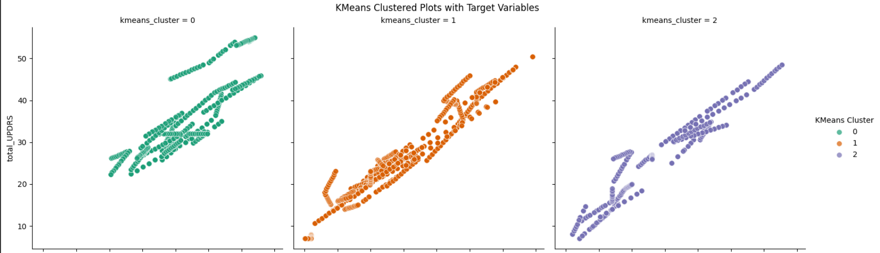
K-means PLOts

Slide 9
Kmeans++
KMeans++ : It is the same as Kmeans but here we select initial centroids using an algorithm.
The algorithm tries to set initial centroids such that centroids are far apart from each other.
KMeans++ will be accuracy : 95.97%
The confusion matrix generated is :
[[477 15
37 646]]

Slide 10
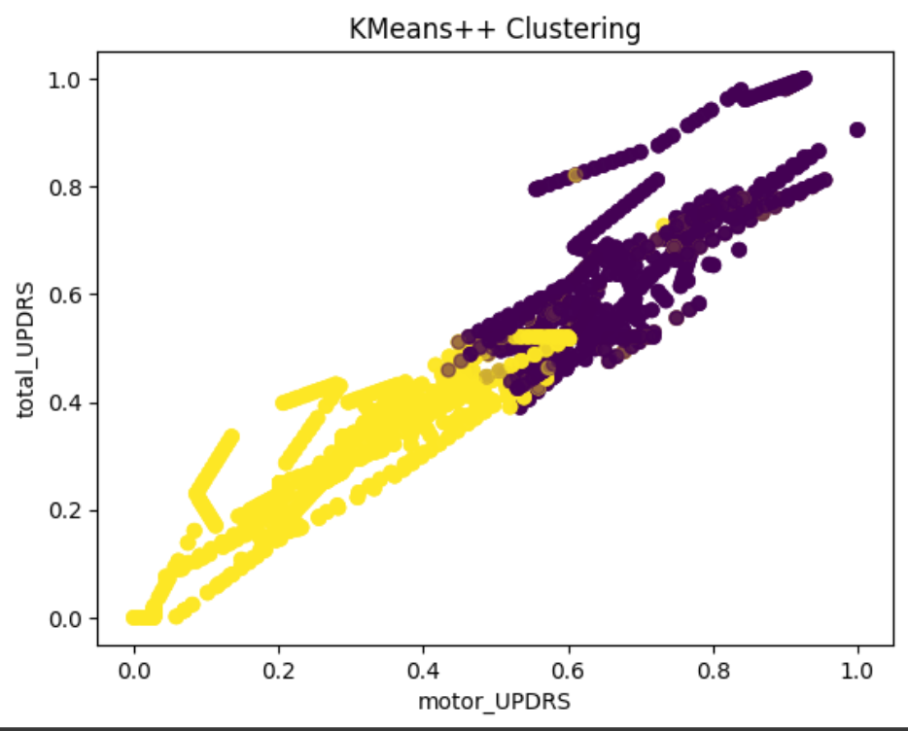
Kmeans++ plot

Slide 11
DBSCAN
DBSCAN is a density-based clustering algorithm that divides a dataset into groups based on the density of data points in the feature space.
Unlike partitioning methods like K-Means, DBSCAN does not require the number of clusters as an input and can discover clusters of arbitrary shapes.
It is particularly effective in identifying clusters embedded in noise and handling varying cluster shapes and sizes.
The accuracy of DBSCAN clustering is :
Accuracy : 100%

Slide 12
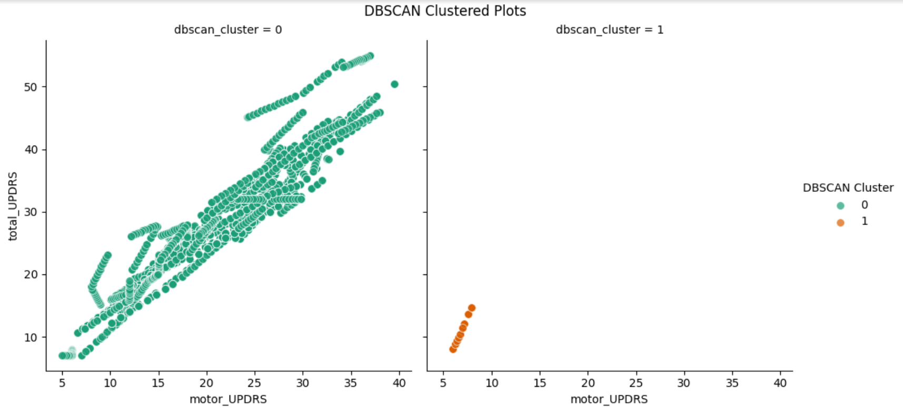
Dbscan plot

Slide 13
OPtics
OPTICS (Ordering Points To Identify the Clustering Structure) is a density-based clustering algorithm that extends the concept of DBSCAN.
It aims to identify clusters of arbitrary shapes and sizes in a dataset while addressing some limitations of DBSCAN.
OPTICS introduces the concept of reachability and produces an "ordered" list of points, providing a more flexible representation of the cluster structure.
The accuracy for OPTICS algorithm is : 96.82% and 97.56%

Slide 14
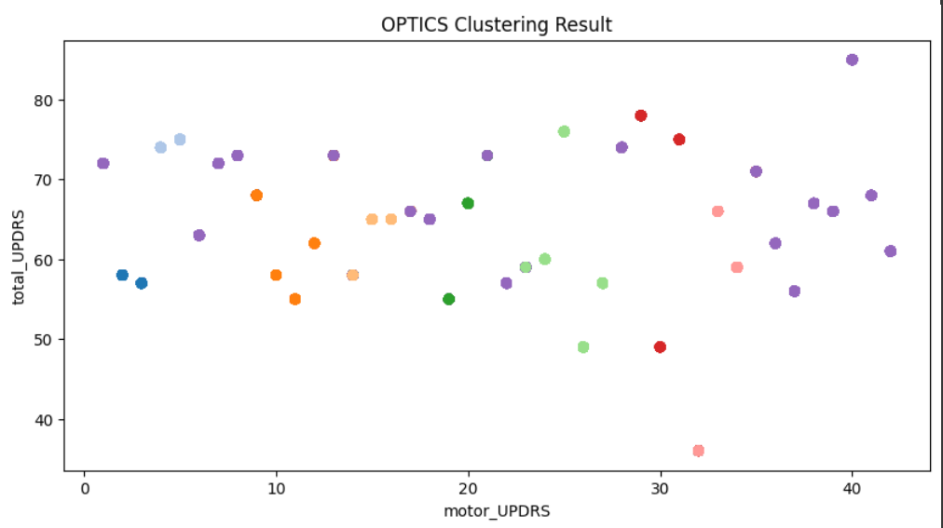
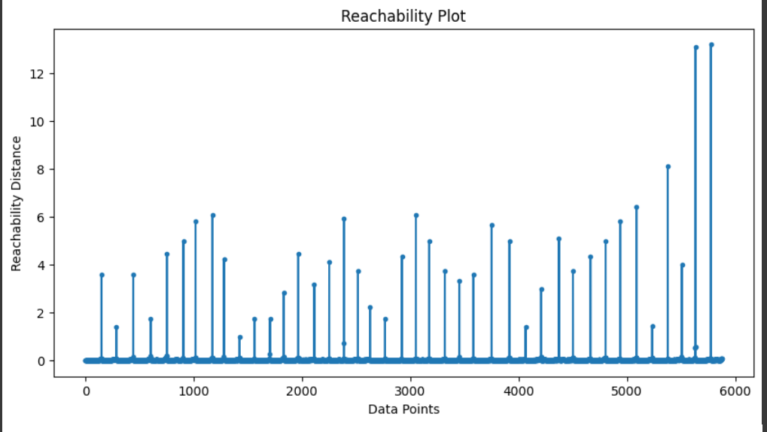
Optics plot

Slide 15
Classification
Used SVM classification method as common classification method for all clustering models so that we can know more about data how it is acting based on different clusters . And as DBScan is not good with clustering in this dataset we used Random forest to make a difference
SVM Classification on KMeans Clustered Data:
Trained SVM on features (motor_UPDRS and total_UPDRS) with labels from KMeans clustering.
Evaluated performance with accuracy and confusion matrix.
Visualized results with a scatter plot showing the SVM decision boundary.
SVM Classification on KMeans++ Clustered Data:
Applied SVM classification on data clustered using KMeans++.
Assessed performance with accuracy and confusion matrix.
Visualized results with a scatter plot depicting the SVM decision boundary.

Slide 16
Classification
Random Forest Classification for DBSCAN:
Implemented Random Forest within DBSCAN-generated clusters.
Created binary target variable based on 'motor_UPDRS' thresholds within each cluster.
Trained, tested, and evaluated Random Forest models for each cluster.
Provided insights into model performance across diverse subsets.
SVM Classification on OPTICS Clustered Data:
Used Support Vector Regression (SVR) to predict 'motor_UPDRS' based on features.
Applied SVR for non-linear relationships and complex patterns.
Trained on a subset, evaluated using Mean Squared Error and R-squared.
Customized kernel type and regularization parameter for different data characteristics.

Slide 17
Cross Validation
Used for evaluating classification model for clustering methods such as k-means, k-means++, optics etc.
Here, we used two method of cross validation:
K-Fold Cross-Validation:
Description: The dataset is divided into k subsets or folds. The model is trained k times, each time using k-1 folds for training and the remaining fold for validation.
Advantages: Provides a good balance between computational efficiency and reliable performance estimation.
Results: K-means:0.92, K-means++: 0.95, Optics: 0.96
Stratified K-Fold Cross-Validation:
Description: Similar to k-fold cross-validation, but it ensures that each fold maintains the same class distribution as the original dataset. This is particularly useful when dealing with imbalanced datasets.
Advantages: Ensures that each fold represents the overall class distribution.
Results: K-means:0.92, K-means++: 0.96, Optics: 0.96

Slide 18
Association Rules and Frequent Item Sets
Data Transformation:
Applied normalization to prepare data for Association Rules analysis.
Conducted a second encoding process for enhanced representation.
Encoding Methods:
Equal Size Encoding:
Split normalized data into equal-size intervals (0.2).
Applied to the transformed dataset independently.
Bell Curve Like Encoding:
Ratios aligned with standard deviations for more nuanced representation.
Implemented separate encoding for the transformed dataset.

Slide 19
Association Rules and Frequent Item Sets
Magnitude-based Encoding:
Identified outliers based on a threshold.
Encoded data considering extreme values beyond one standard deviation.
Combination Strategies:
Explored various combinations of encoding methods and threshold values.
Conducted encoding independently from the source of truth for versatility.
Association Rules Analysis Results:
Despite efforts, the analysis did not yield actionable insights.
Suggested potential for valuable results with further exploration.
Recommends additional analysis to uncover meaningful patterns.

Slide 20
Conclusion
Value in Data Mining:
Data mining techniques hold potential for valuable insights.
Larger Dataset Importance:
Advocate for a larger dataset for more personalized insights.
Focus on OPTICS:
Prioritize OPTICS and related clustering algorithms for analysis.
Priority on Association Rules:
Emphasize the novel approach of using Association Rules over clustering.

Slide 21
Conclusion
Longitudinal Perspective:
Explore data relationships longitudinally, e.g., time trial x0 to x1.
K++ is best clustering
Association rules are promising
Data is dense and that drives options
More data is always better

Slide 22
Reference
[1] Surangsrirat D, Sri-Iesaranusorn P,Chaiyaroj A, Vateekul P, Bhidayasiri R. Parkinson’s disease severity clustering based on tapping activity on mobile device.
[2] Hendricks, R. M., & Khasawneh, M. T. (2021).A Systematic Review of Parkinson’s Disease Cluster Analysis Research.
[3] Mehrbakhsh Nilashi, Othman Ibrahim, Sarminah Samad, Hossein Ahmadi, Leila Shahmoradi, Elnaz Akbari, An analytical method for measuring the Parkinson’s disease progression: A case on a Parkinson’s telemonitoring dataset, Measurement,https://doi.org/10.1016/j.measurement.2019.01.014.
[4] Garc´ıa-Ordas, Mar ´ ´ıa & Ben´ıtez-Andrades, Jose & Aveleira, ´ Jose & Alija-Perez, Jose & Benavides, Carmen. (2023). Determining the severity of Parkinson’s disease in patients using a multi task neural network. Multimedia Tools and Applications. 10.1007/s11042-023-14932-x.
[5] Israa Ali Alshabeeb, Nidaa Ghalib Ali, Saba Abdulameer Naser, Wafaa M. R. Shakir. A Clustering Algorithm Application in Parkinson Disease based on kmeans Method

Slide 23
Reference
[6] Hendricks, R., & Khasawneh, M. (2021). Cluster Analysis of Categorical Variables of Parkinson’s Disease Patients. Brain sciences, 11(10), 1290. https://doi.org/10.3390/brainsci11101290.
[7] Ram Deepak Gottapu, Cihan H Dagli,Analysis of Parkinson’s Disease Data,Procedia Computer Science,Volume 140,2018,Pages 334-341,ISSN 1877- 0509, https://doi.org/10.1016/j.procs.2018.10.306.
[8] Tucker, C., Han, Y., Nembhard, H. B., Lewis, M., Lee, W. C., Sterling, N. W., & Huang, X. (2015). A data mining methodology for predicting early stage Parkinson’s disease using non-invasive, high-dimensional gait sensor data. IIE transactions on healthcare systems engineering, 5(4), 238–254.
[9] Dinov, I. D., Heavner, B., Tang, M., Glusman, G., Chard, K., Darcy, M., Madduri, R., Pa, J., Spino, C., Kesselman, C., Foster, I., Deutsch, E. W., Price, N. D., Van Horn, J. D., Ames, J., Clark, K., Hood, L., Hampstead, B. M., Dauer, W., & Toga, A. W. (2016). Predictive Big Data Analytics: A Study of Parkinson’s Disease Using Large, Complex, Heterogeneous, Incongruent, MultiSource and Incomplete Observations. PloS one, 11(8), e0157077. https://doi.org/10.1371/journal.pone.0157077
[10] Zhang, J. Mining imaging and clinical data with machine learning approaches for the diagnosis and early detection of Parkinson’s disease. npj Parkinsons Dis. 8, 13 (2022). https://doi.org/10.1038/s41531-021-00266-8

